Slide 1

Introduction To Statistics
„There are three kinds of lies: lies, damned lies, and statistics.“ (B.Disraeli)

Slide 2
Why study statistics?
Data are everywhere
Statistical techniques are used to make many decisions that affect our lives
No matter what your career, you will make professional decisions that involve data. An understanding of statistical methods will help you make these decisions efectively

Slide 3
Applications of statistical concepts in the business world
Finance – correlation and regression, index numbers, time series analysis
Marketing – hypothesis testing, chi-square tests, nonparametric statistics
Personel – hypothesis testing, chi-square tests, nonparametric tests
Operating management – hypothesis testing, estimation, analysis of variance, time series analysis

Slide 4
1.1: What is Statistics?
Statistics: The science of collecting, describing, and interpreting data.
Two areas of statistics:
Descriptive Statistics: collection, presentation, and description of sample data.
Inferential Statistics: making decisions and drawing conclusions about populations.

Slide 5

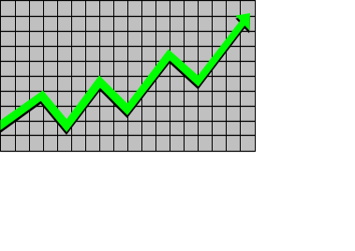
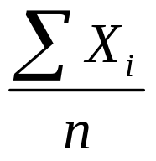
Descriptive Statistics
Collect data
  e.g., Survey
Present data
  e.g., Tables and graphs
Summarize data
  e.g., Sample mean =

Slide 6
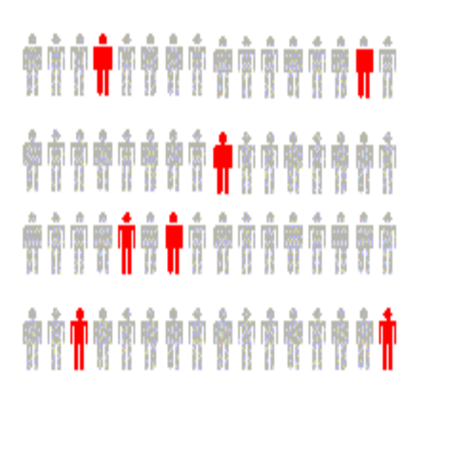
Inferential Statistics
Estimation
  e.g., Estimate the population mean weight using the sample mean weight
Hypothesis testing
  e.g., Test the claim that the population mean weight is 70 kg
Inference is the process of drawing conclusions or making decisions about a population based on sample results

Slide 7
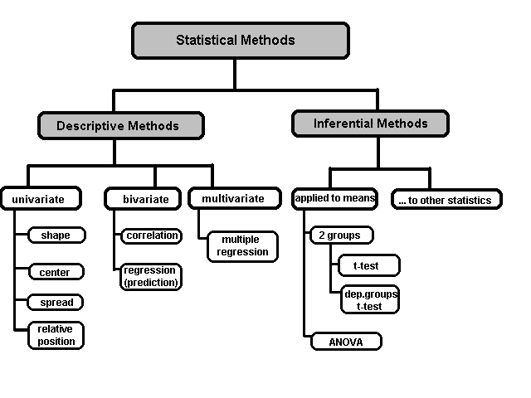
A Taxonomy of Statistics

Slide 8
Example: A recent study examined the math and verbal SAT scores of high school seniors across the country. Which of the following statements are descriptive in nature and which are inferential.
The mean math SAT score was 492.
The mean verbal SAT score was 475.
Students in the Northeast scored higher in math but lower in verbal.
80% of all students taking the exam were headed for college.
32% of the students scored above 610 on the verbal SAT.
The math SAT scores are higher than they were 10 years ago.

Slide 9
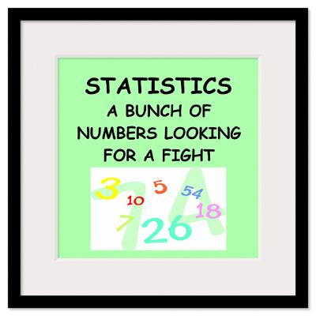

Slide 10
Statistical data
The collection of data that are relevant to the problem being studied is commonly the most difficult, expensive, and time-consuming part of the entire research project.
Statistical data are usually obtained by counting or measuring items.
  Primary data are collected specifically for the analysis desired
  Secondary data have already been compiled and are available for statistical analysis
A variable is an item of interest that can take on many different numerical values.
A constant has a fixed numerical value.

Slide 11
Data
Statistical data are usually obtained by counting or measuring items. Most data can be put into the following categories:
Qualitative - data are measurements that each fail into one of several categories. (hair color, ethnic groups and other attributes of the population)
quantitative - data are observations that are measured on a numerical scale (distance traveled to college, number of children in a family, etc.)

Slide 12
Qualitative data
Qualitative data are generally described by words or
letters. They are not as widely used as quantitative data
because many numerical techniques do not apply to the
qualitative data. For example, it does not make sense to
find an average hair color or blood type.
Qualitative data can be separated into two subgroups:
dichotomic (if it takes the form of a word with two options (gender - male or female)
polynomic (if it takes the form of a word with more than two options (education - primary school, secondary school and university).

Slide 13
Quantitative data
Quantitative data are always numbers and are the
result of counting or measuring attributes of a population.
Quantitative data can be separated into two
subgroups:
discrete (if it is the result of counting (the number of students of a given ethnic group in a class, the number of books on a shelf, ...)
continuous (if it is the result of measuring (distance traveled, weight of luggage, …)

Slide 14
Numerical scale of measurement:
Nominal – consist of categories in each of which the number of respective observations is recorded. The categories are in no logical order and have no particular relationship. The categories are said to be mutually exclusive since an individual, object, or measurement can be included in only one of them.
Ordinal – contain more information. Consists of distinct categories in which order is implied. Values in one category are larger or smaller than values in other categories (e.g. rating-excelent, good, fair, poor)
Interval – is a set of numerical measurements in which the distance between numbers is of a known, sonstant size.
Ratio – consists of numerical measurements where the distance between numbers is of a known, constant size, in addition, there is a nonarbitrary zero point.

Slide 15
1.2 Introduction to Basic Terms
Population: A collection, or set, of individuals or objects or events whose properties are to be analyzed.
Two kinds of populations: finite or infinite.
Sample: A subset of the population.

Slide 16
Variable: A characteristic about each individual element of a population or sample.
Data (singular): The value of the variable associated with one element of a population or sample. This value may be a number, a word, or a symbol.
Data (plural): The set of values collected for the variable from each of the elements belonging to the sample.
Experiment: A planned activity whose results yield a set of data.
Parameter: A numerical value summarizing all the data of an entire population.
Statistic: A numerical value summarizing the sample data.

Slide 17
Example: A college dean is interested in learning about the average age of faculty. Identify the basic terms in this situation.
The population is the age of all faculty members at the college.
A sample is any subset of that population. For example, we might select 10 faculty members and determine their age.
The variable is the “age” of each faculty member.
One data would be the age of a specific faculty member.
The data would be the set of values in the sample.
The experiment would be the method used to select the ages forming the sample and determining the actual age of each faculty member in the sample.
The parameter of interest is the “average” age of all faculty at the college.
The statistic is the “average” age for all faculty in the sample.

Slide 18
Two kinds of variables:
Qualitative, or Attribute, or Categorical, Variable: A variable that categorizes or describes an element of a population.
Note: Arithmetic operations, such as addition and averaging, are not meaningful for data resulting from a qualitative variable.
Quantitative, or Numerical, Variable: A variable that quantifies an element of a population.
Note: Arithmetic operations such as addition and averaging, are meaningful for data resulting from a quantitative variable.

Slide 19
Types of variables
Variables
Qualitative
Quantitative
Dichotomic/Nominal
Polynomic/Ordinal
Discrete
Continuous
Gender, marital status
Brand of Pc, hair color
Children in family, Strokes on a golf hole
Amount of income tax paid, weight of a student

Slide 20
Example: Identify each of the following examples as attribute (qualitative) or numerical (quantitative) variables.
1. The residence hall for each student in a statistics class. (Attribute)
2. The amount of gasoline pumped by the next 10 customers at the local Unimart. (Numerical)
3. The amount of radon in the basement of each of 25 homes in a new development. (Numerical)
4. The color of the baseball cap worn by each of 20 students. (Attribute)
5. The length of time to complete a mathematics homework assignment. (Numerical)
6. The state in which each truck is registered when stopped and inspected at a weigh station. (Attribute)

Slide 21
Nominal Variable: A qualitative variable that categorizes (or describes, or names) an element of a population.
Ordinal Variable: A qualitative variable that incorporates an ordered position, or ranking.
Discrete Variable: A quantitative variable that can assume a countable number of values. Intuitively, a discrete variable can assume values corresponding to isolated points along a line interval. That is, there is a gap between any two values.
Continuous Variable: A quantitative variable that can assume an uncountable number of values. Intuitively, a continuous variable can assume any value along a line interval, including every possible value between any two values.

Slide 22
Example: Identify each of the following as examples of qualitative or numerical variables:
1. The temperature in Barrow, Alaska at 12:00 pm on any
given day.
2. The make of automobile driven by each faculty member.
3. Whether or not a 6 volt lantern battery is defective.
4. The weight of a lead pencil.
5. The length of time billed for a long distance telephone call.
6. The brand of cereal children eat for breakfast.
7. The type of book taken out of the library by an adult.

Slide 23
Example: Identify each of the following as examples of (1) nominal, (2) ordinal, (3) discrete, or (4) continuous variables:
1. The length of time until a pain reliever begins to work.
2. The number of chocolate chips in a cookie.
3. The number of colors used in a statistics textbook.
4. The brand of refrigerator in a home.
5. The overall satisfaction rating of a new car.
6. The number of files on a computer’s hard disk.
7. The pH level of the water in a swimming pool.
8. The number of staples in a stapler.

Slide 24

What type of statistical test do I want to do?

Slide 25
Ordinal Data
Beyond the capability of Excel – just FYI
If comparing 2 groups
  Mann Whitney U (treatment vs. control)
  Wilcoxon (matched pre vs. post)
If comparing > 2 groups
  Kruskal-Wallis (median test)
If measuring association between 2 variables
  Spearman rho (ρ)
Likert-type scales are ordinal data
9/14/2010

Slide 26
Continuous Data
If comparing 2 groups (treatment/control)
  t-test
If comparing > 2 groups
  ANOVA (F-test)
If measuring association between 2 variables
  Pearson r correlation
If trying to predict an outcome (crystal ball)
  Regression or multiple regression
9/14/2010

